Slide 1
Trinbago Progressive Assoc Closing Ceremony

Slide 2
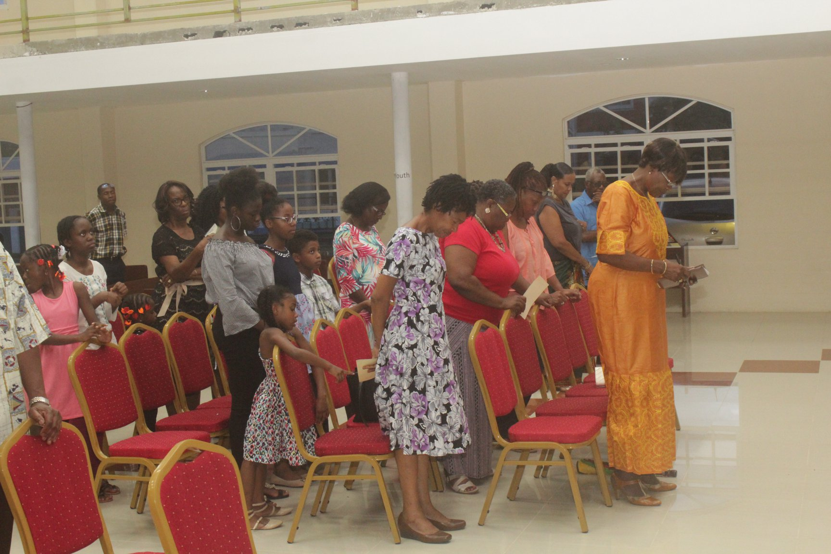
Councillor Dr. Carrington (front row) participating in the scheduled activities. — with Agatha Carrington at Canaan Seventh Day Adventist Church Tobago.

Slide 3
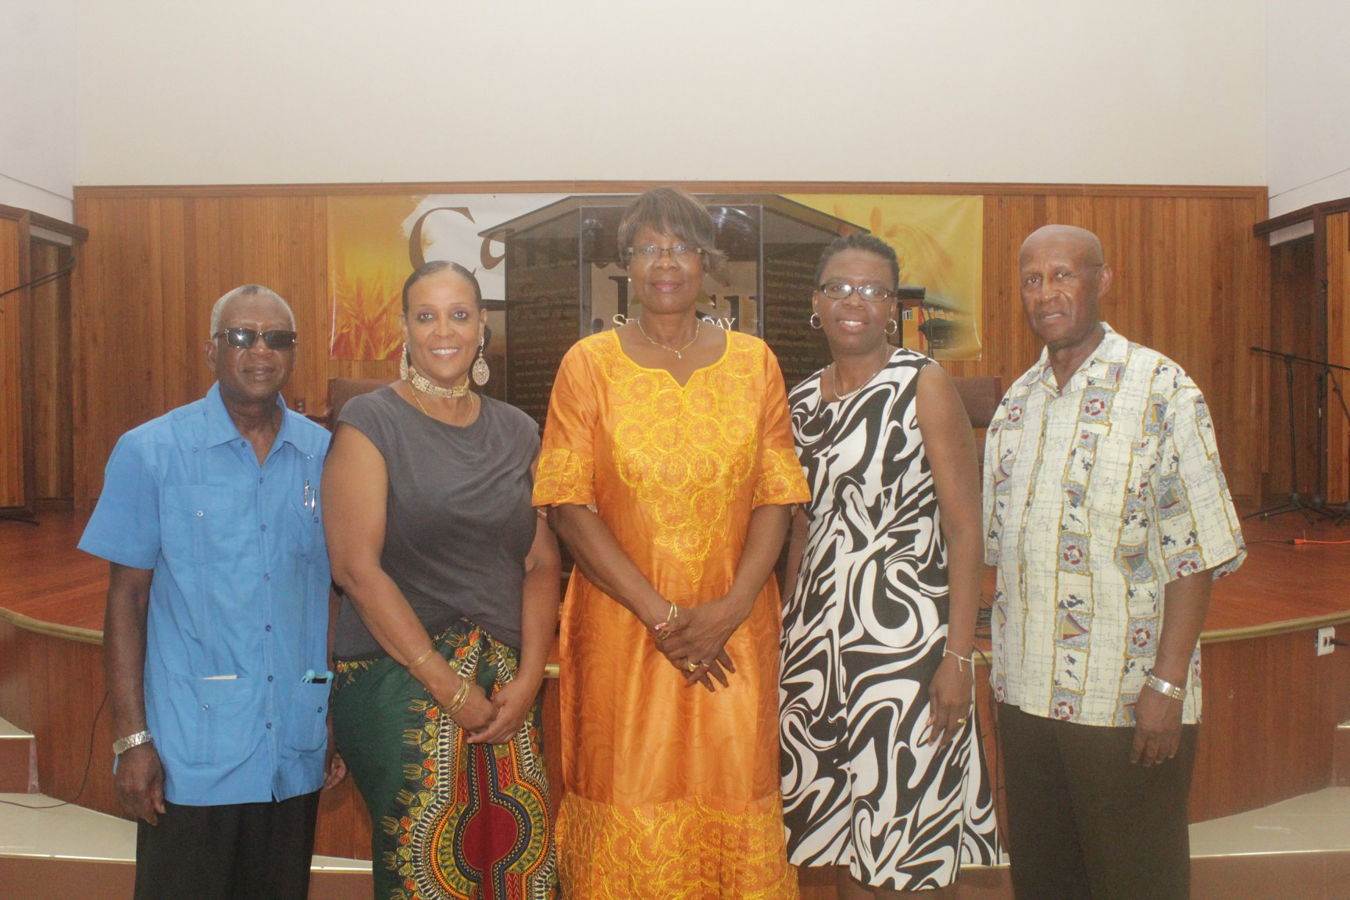
Photo Op! From left: Mr. Stephen Isaac, President of TPA; Ms. Avril Trancoso, Medical Missions Coordinator, TPA; Councillor Dr. Agatha Carrington, Secretary of Health, Wellness and Family Development; Mrs. Dianne Baker Henry, Administrator in the Division of Health, Wellness and Family Development and Mr. Sylvan Maurice Henry, PRO, TPA. — with Agatha Carrington and Dianne Baker-Henry at Canaan Seventh Day Adventist Church Tobago.

Slide 4
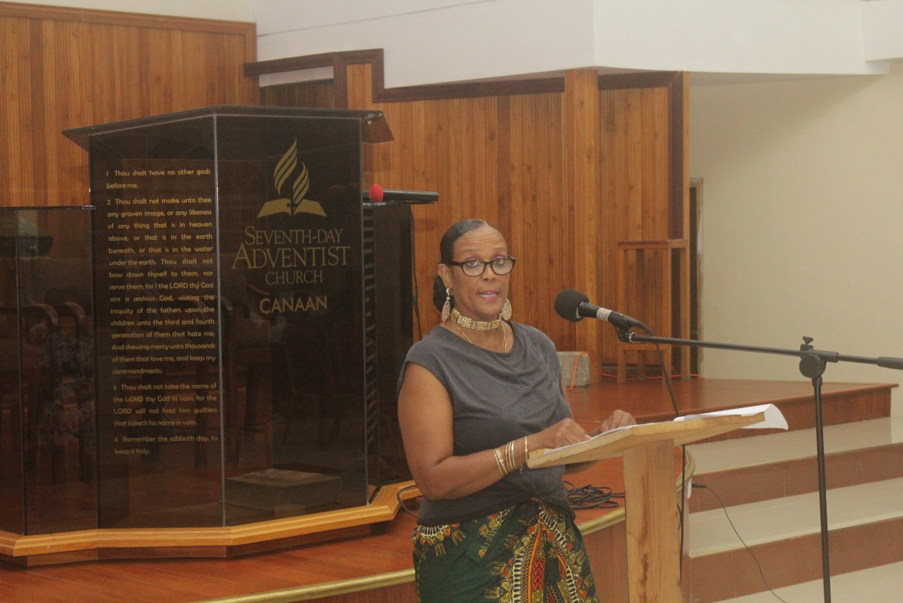
Ms. Avril Trancoso, Medical Missions Coordinator, TPA during the delivery of her presentation. — at Canaan Seventh Day Adventist Church Tobago.

Slide 5
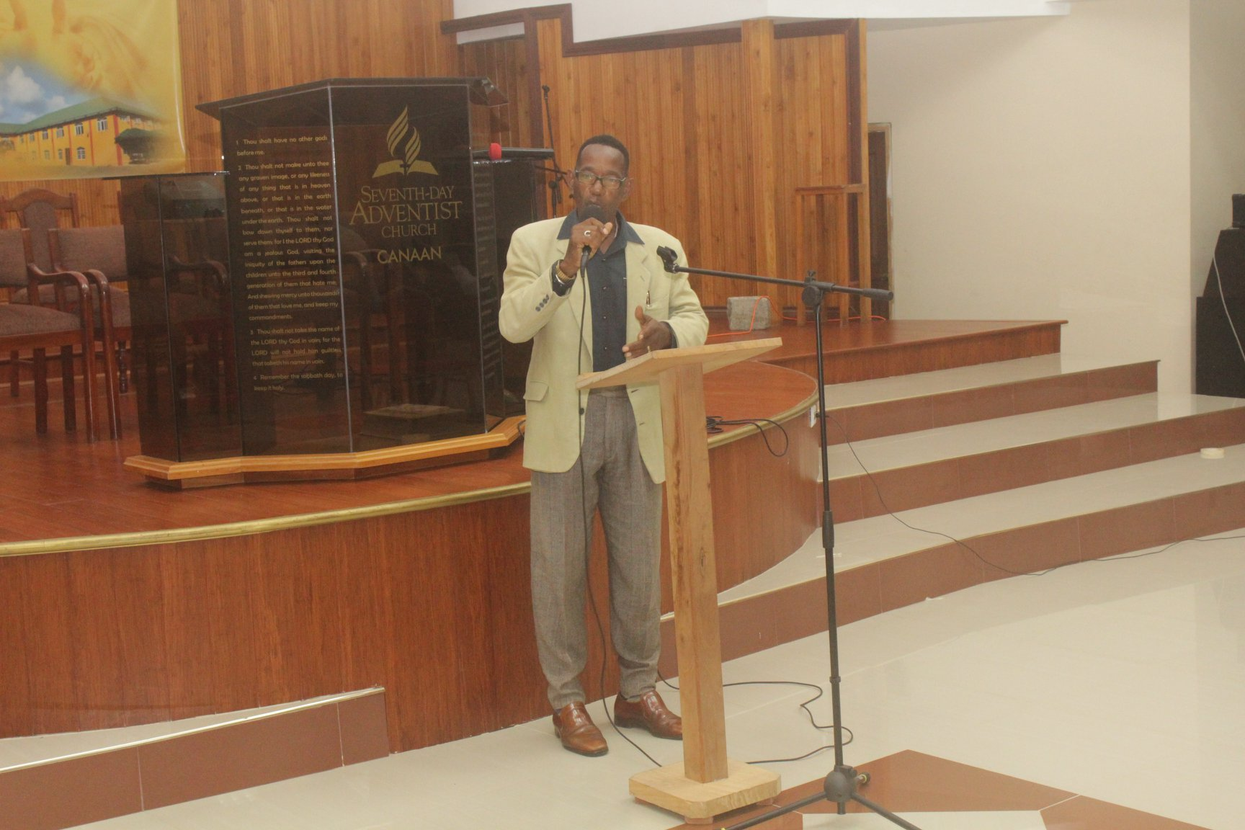
Mr. Granville delivering a performance to the audience. — at Canaan Seventh Day Adventist Church Tobago.

Slide 6
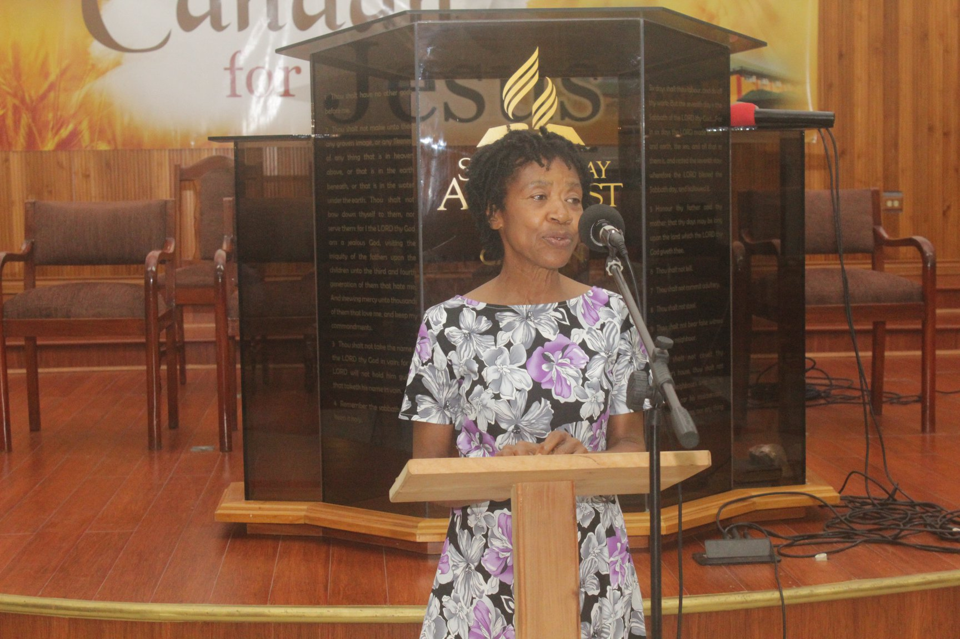
Mrs. Miriam Caesar Moore performed the duties as Master of Ceremonies. — at Canaan Seventh Day Adventist Church Tobago.

Slide 7
THANK YOU! T&T

