Slide 1
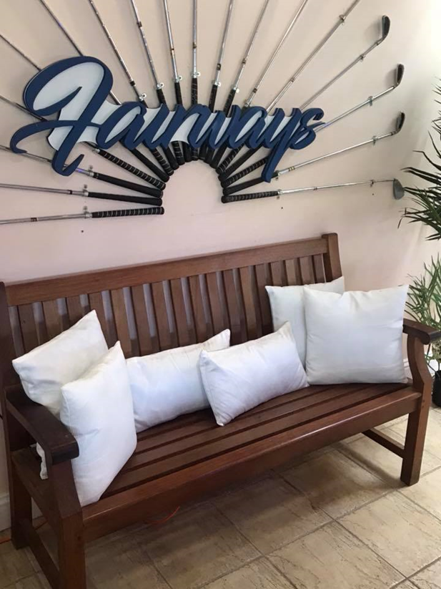

Slide 3
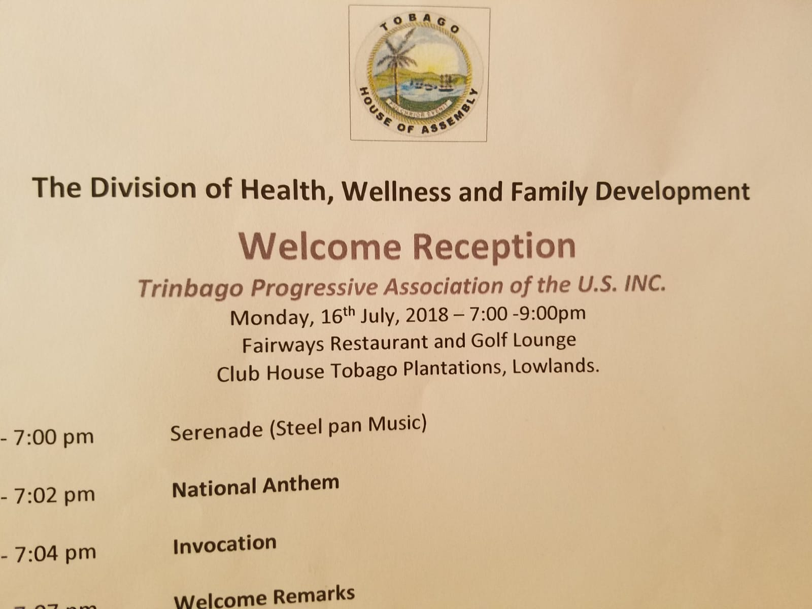

Slide 4
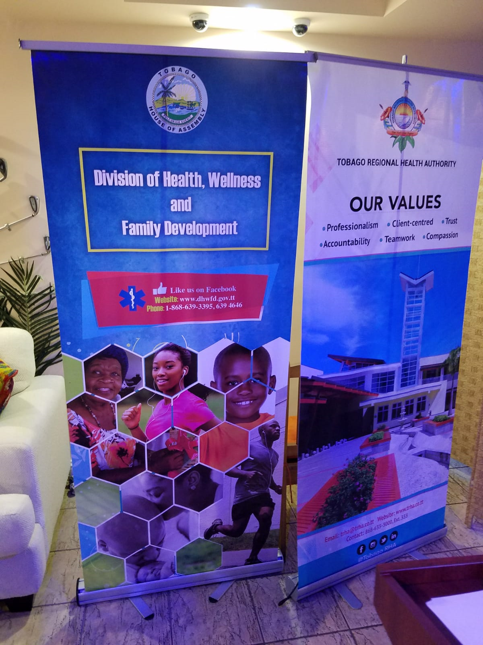

Slide 5
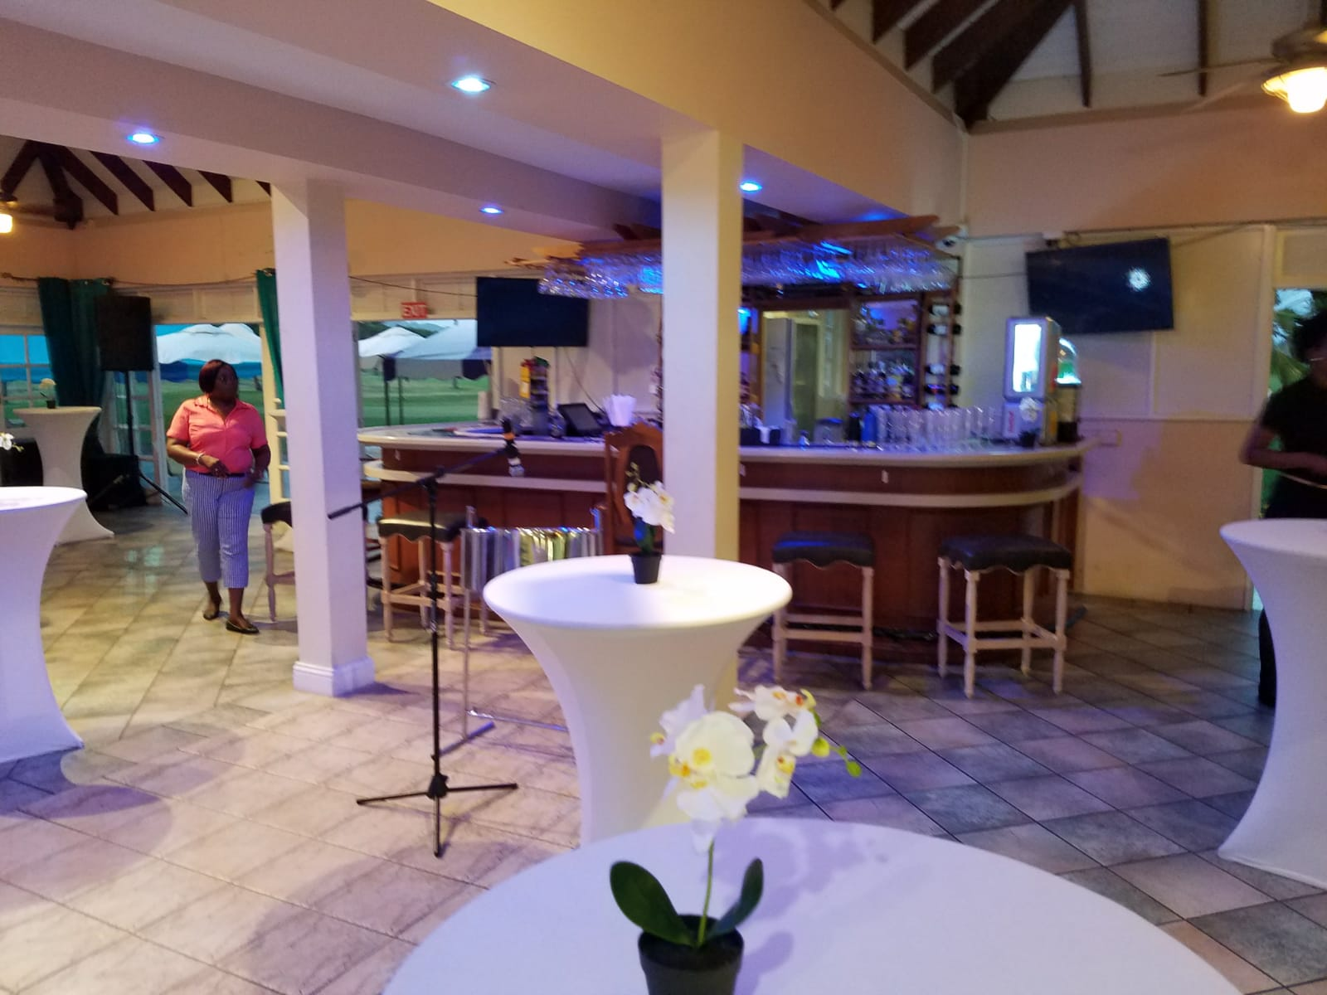

Slide 6
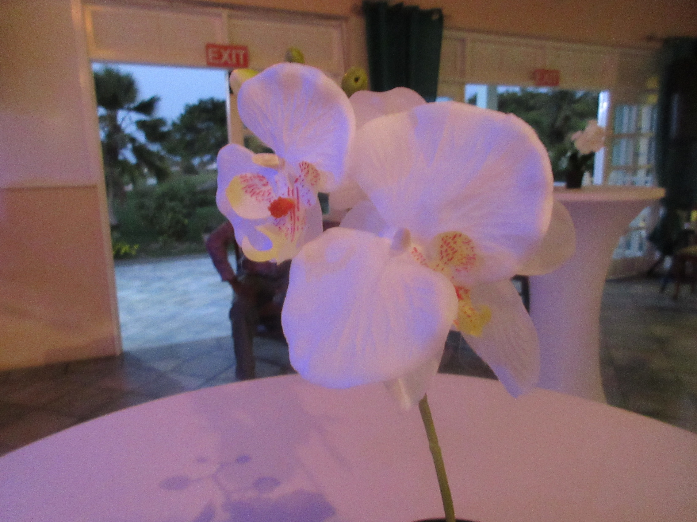

Slide 7
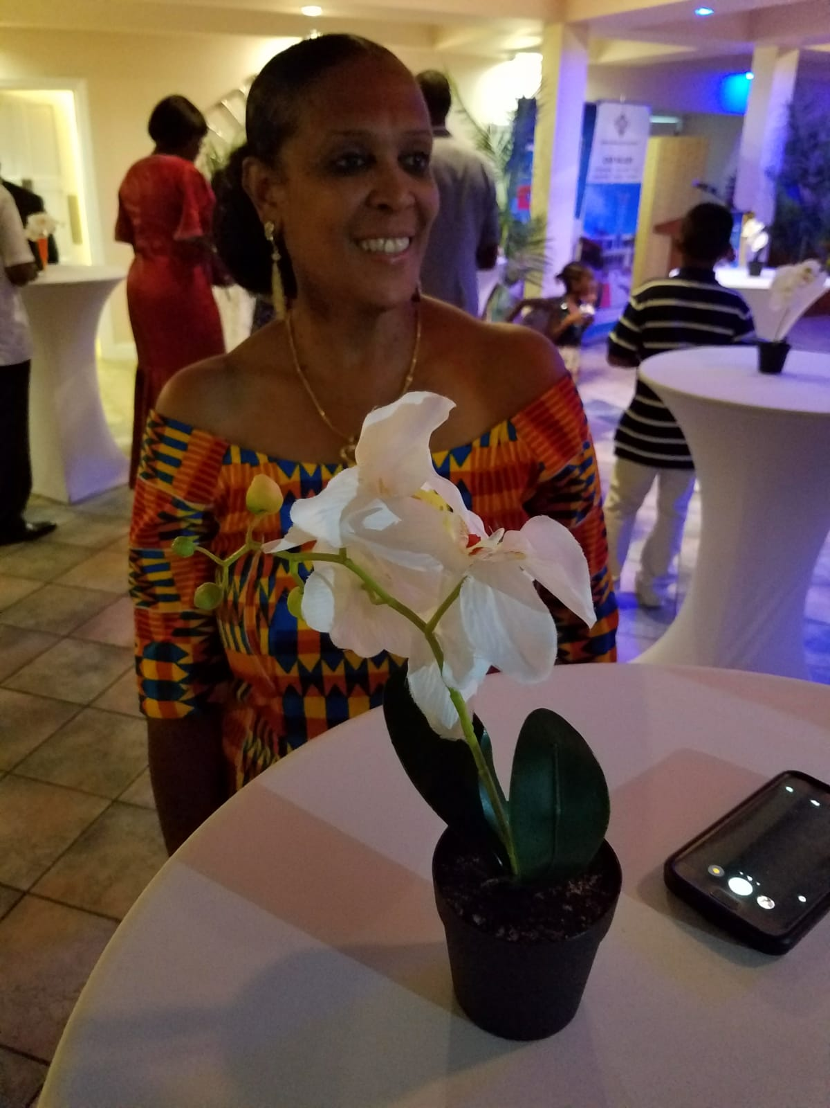

Slide 8
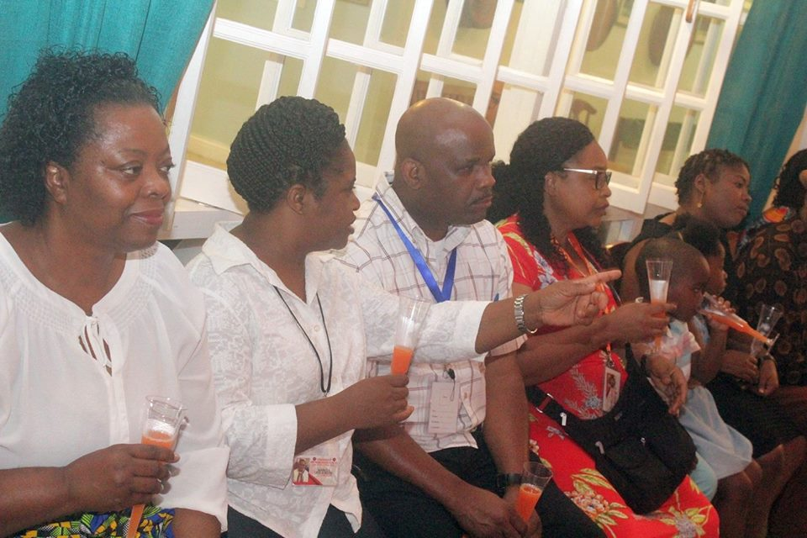

Slide 9
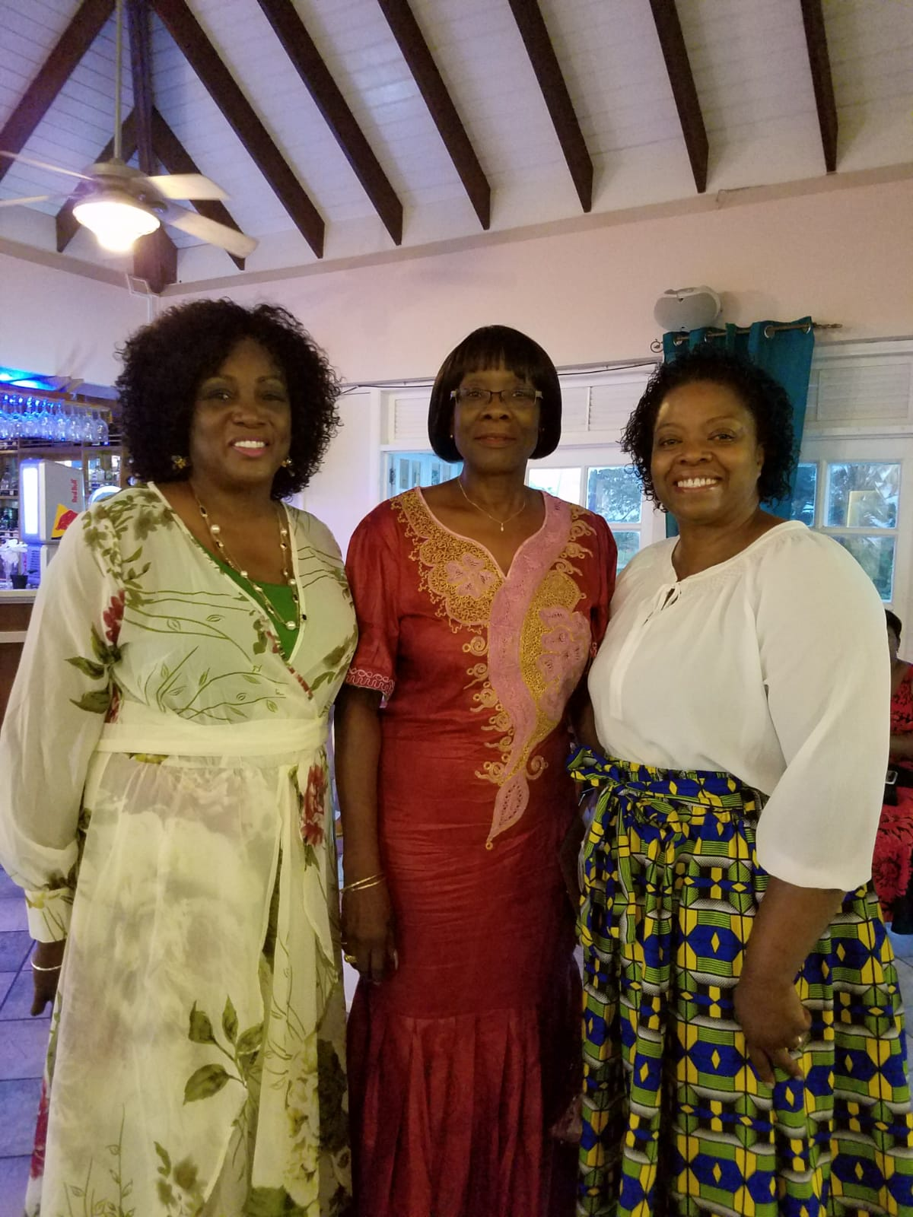

Slide 10
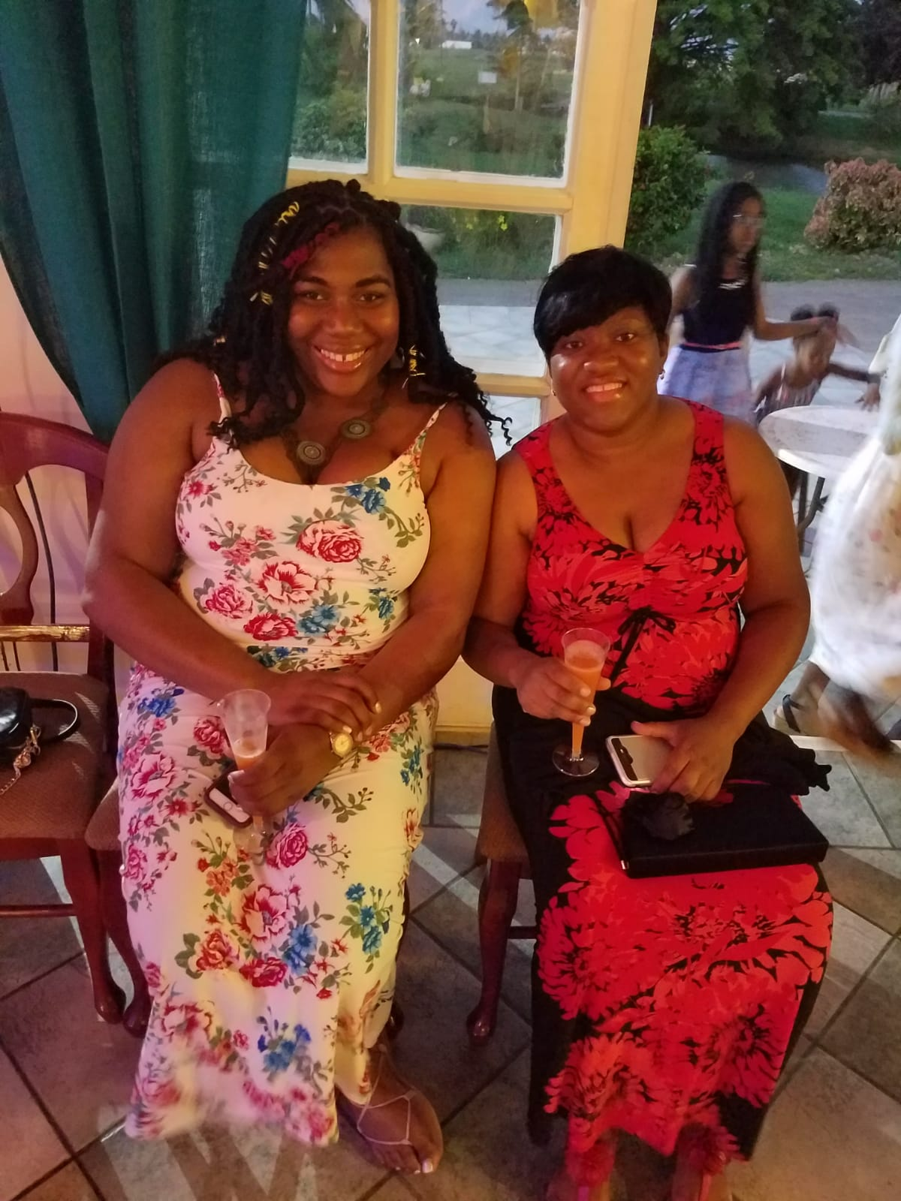

Slide 11
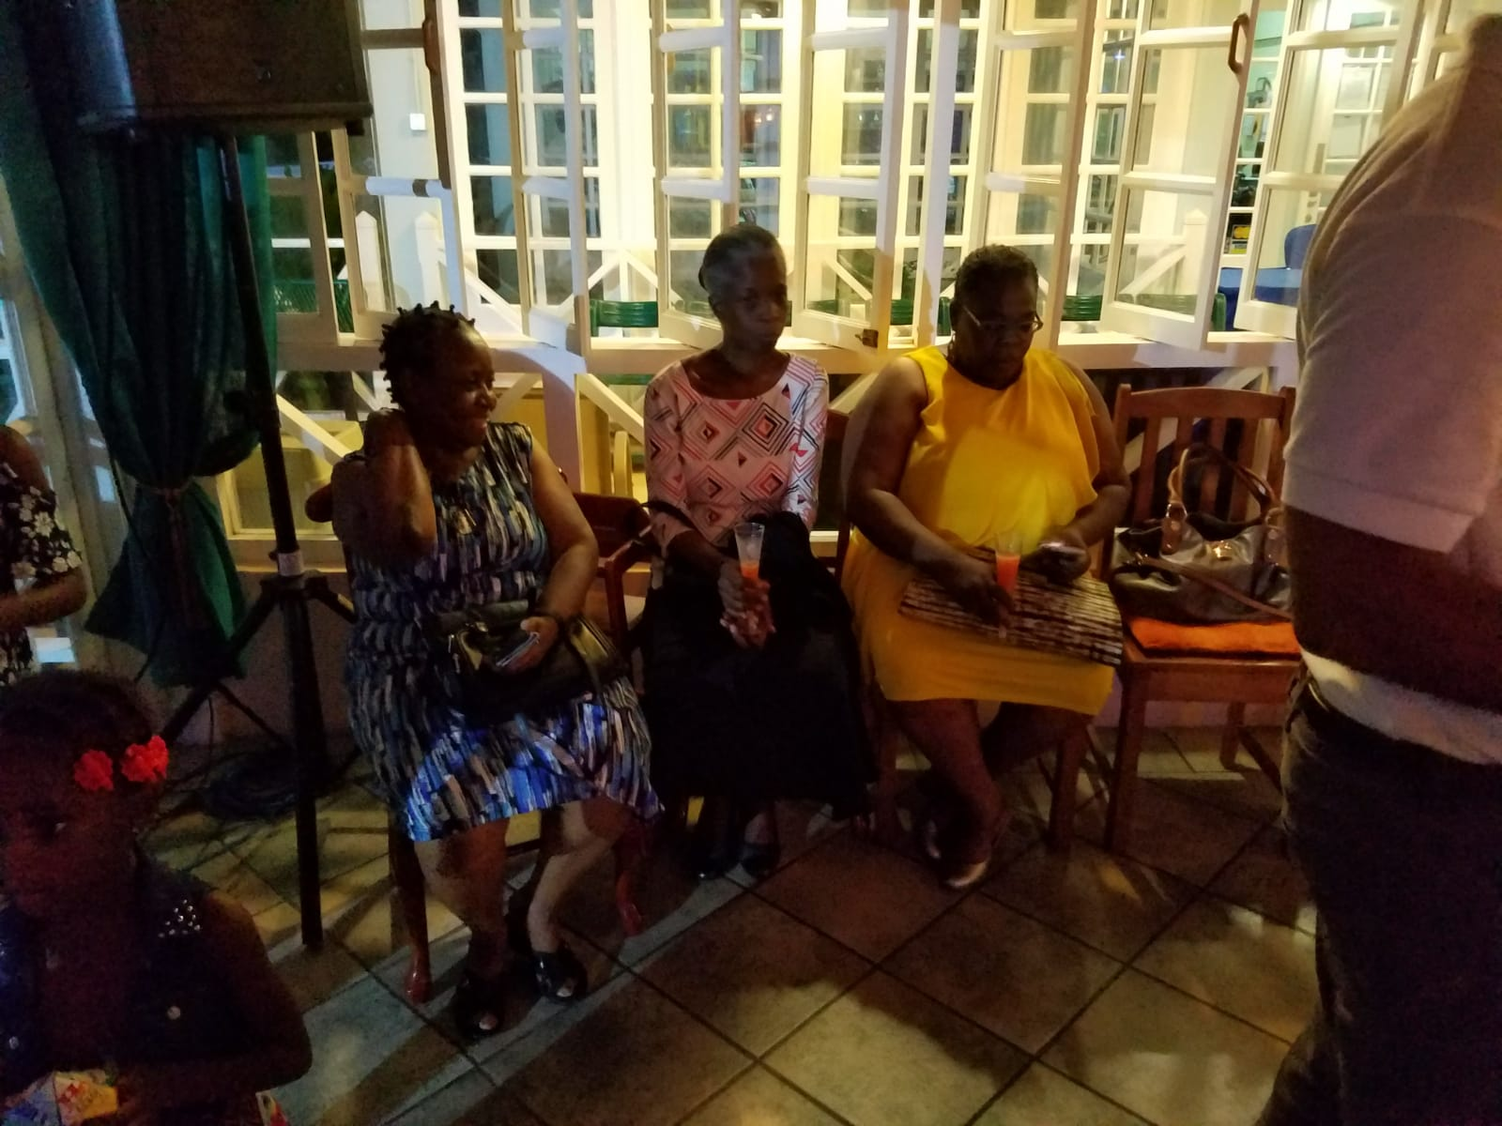

Slide 12
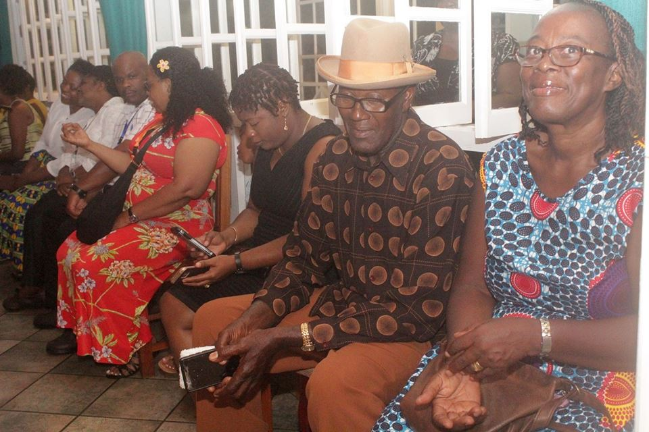

Slide 13
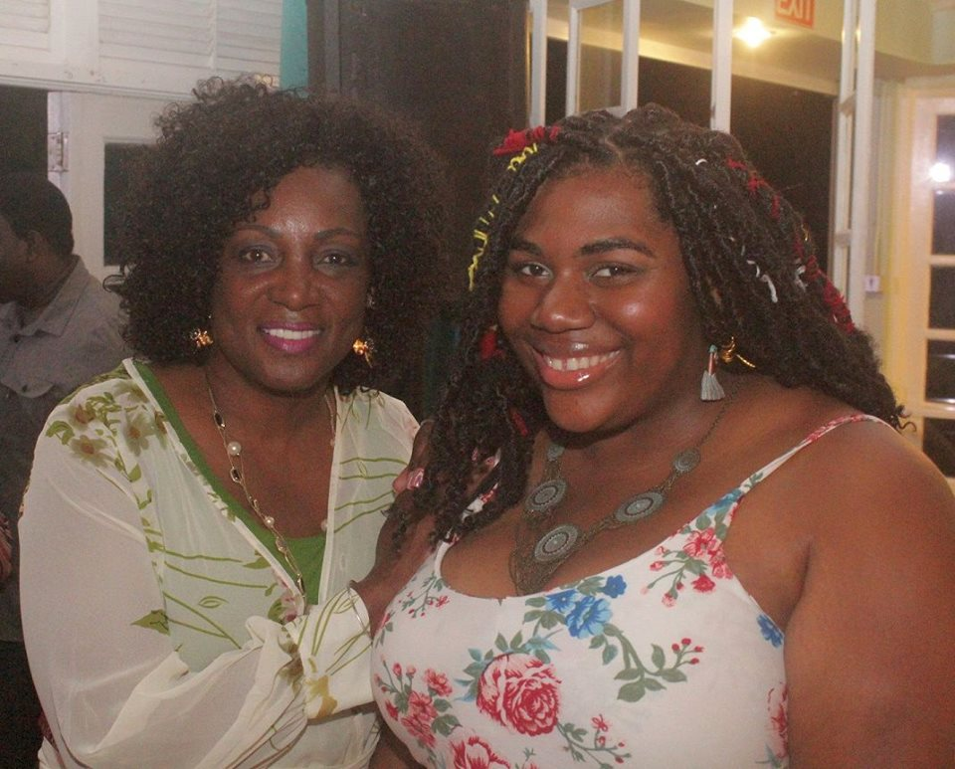

Slide 14
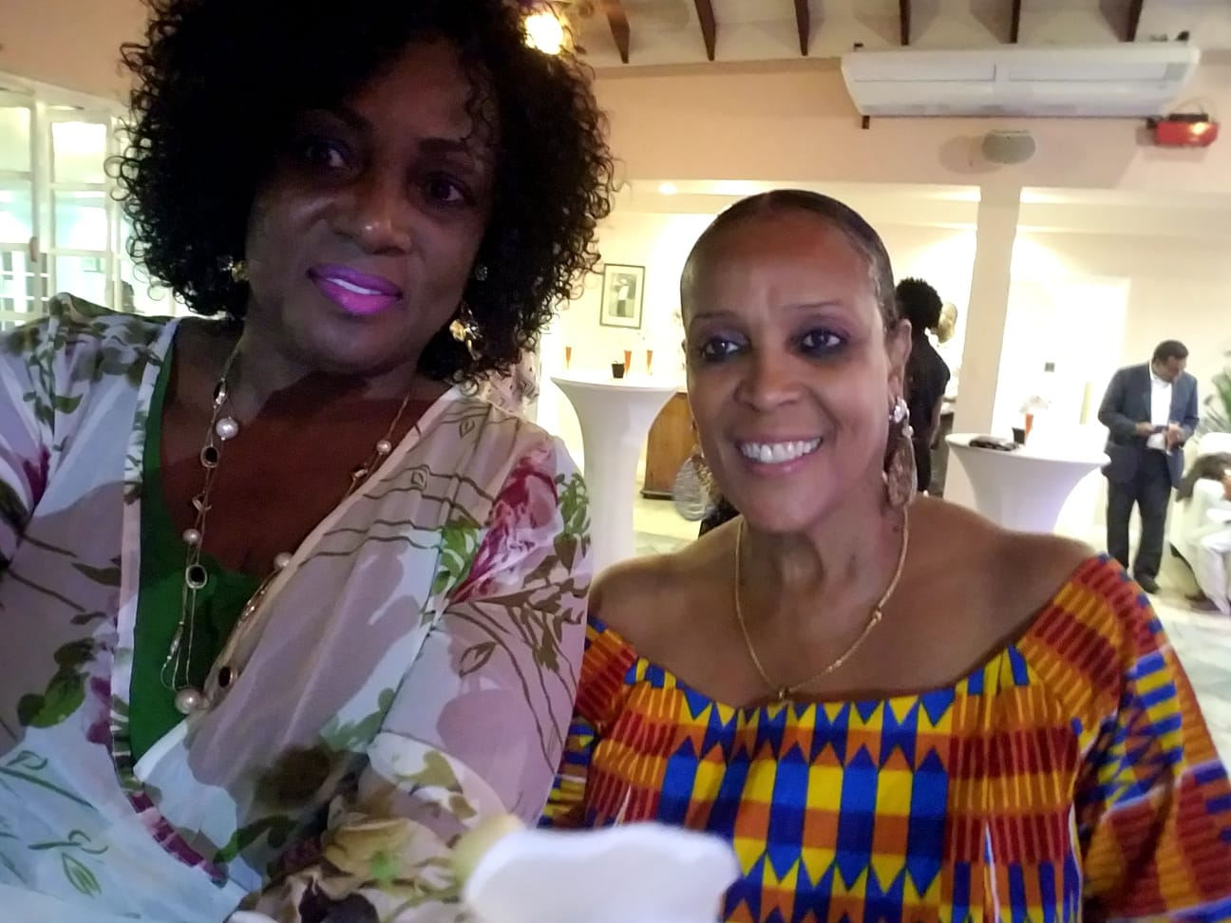

Slide 15
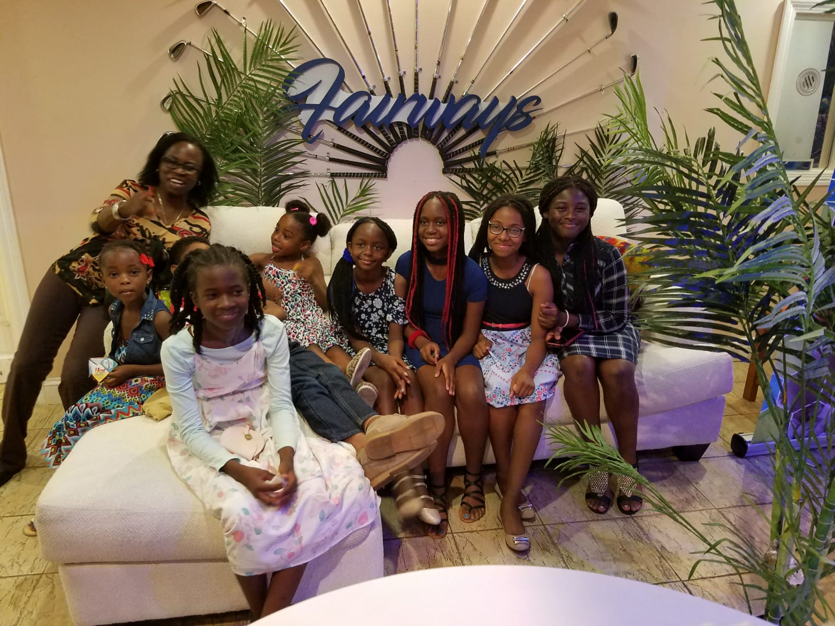

Slide 16
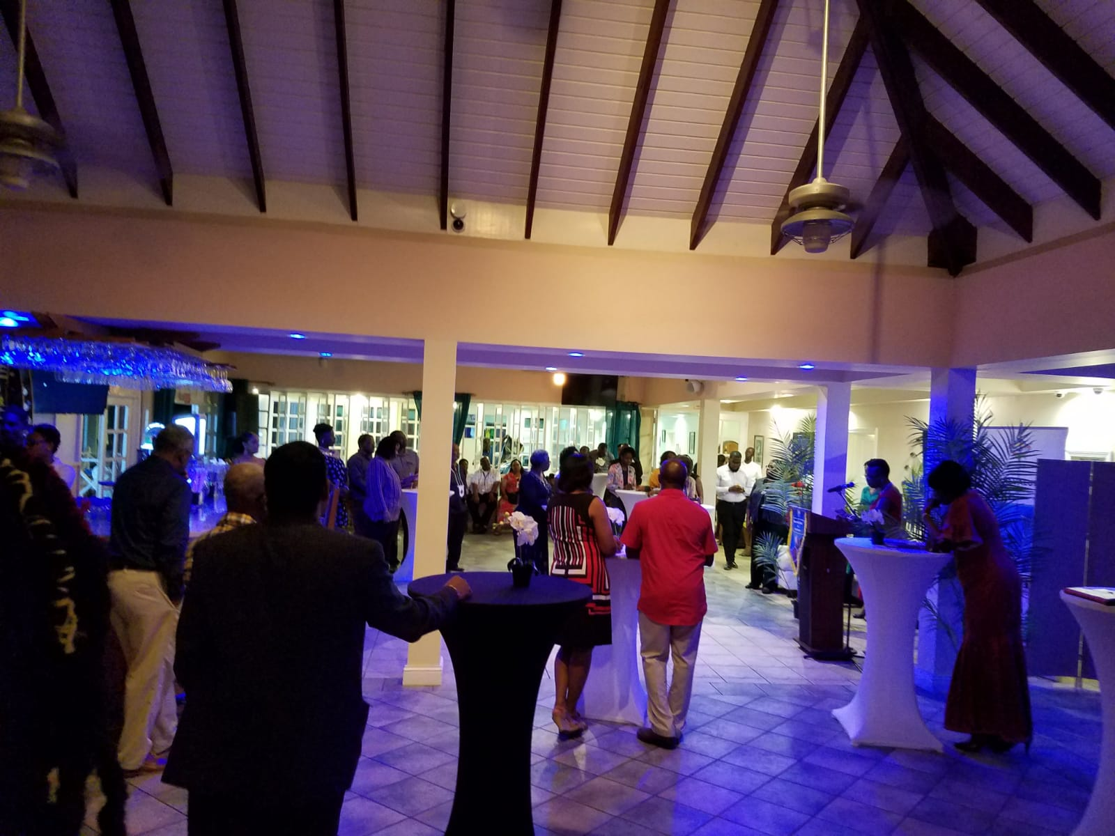

Slide 17
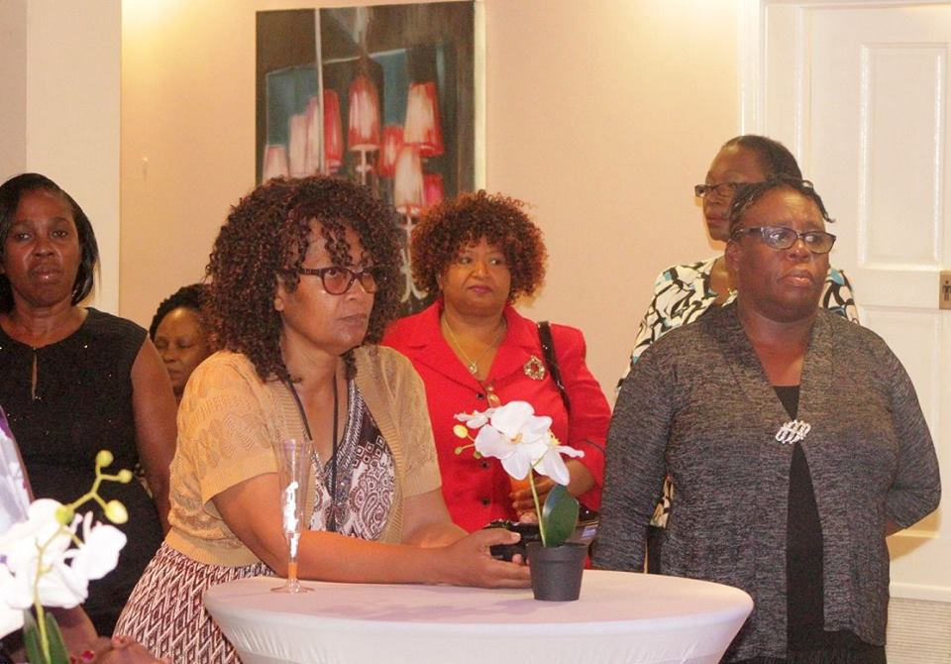

Slide 18
Pose for a Photo Op! From left: Mr Stephen Isaac (l), President of the Trinbago Progressive Association, Mrs. Claire Davidson Williams, Administrator of the Division of Tourism, Culture and Transportation, Mr. Williams and Dr. Daniel Beckles (r), member of the TPA.

Slide 19
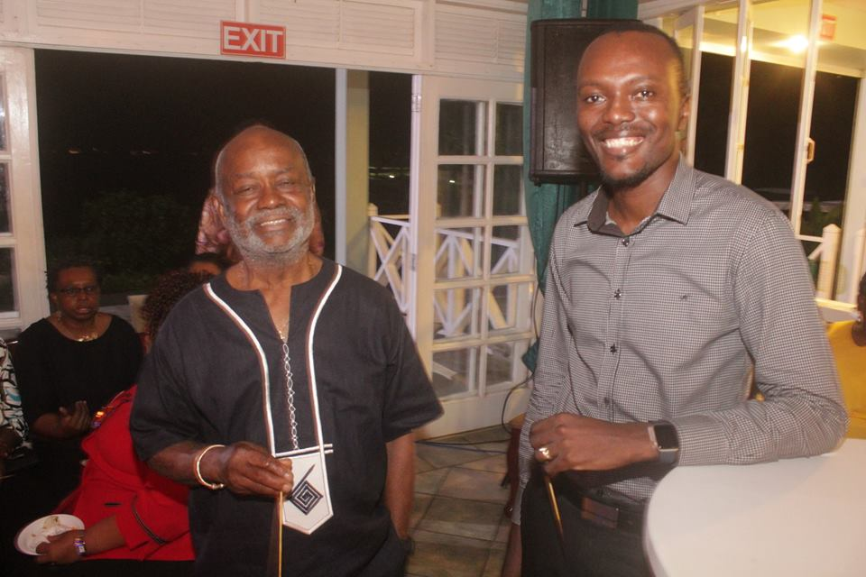
From left; Mr. Stanford Callendar - TRHA Board Director of Public Interest and Welfare and Assemblyman Ancil Dennis, Assistant Secretary in the Office of the Chief Secretary

Slide 20
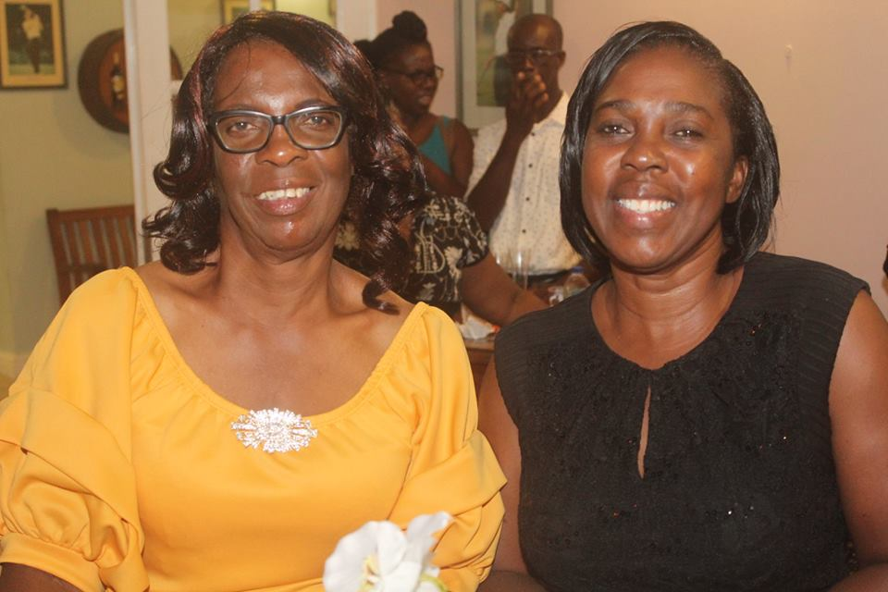

Slide 21
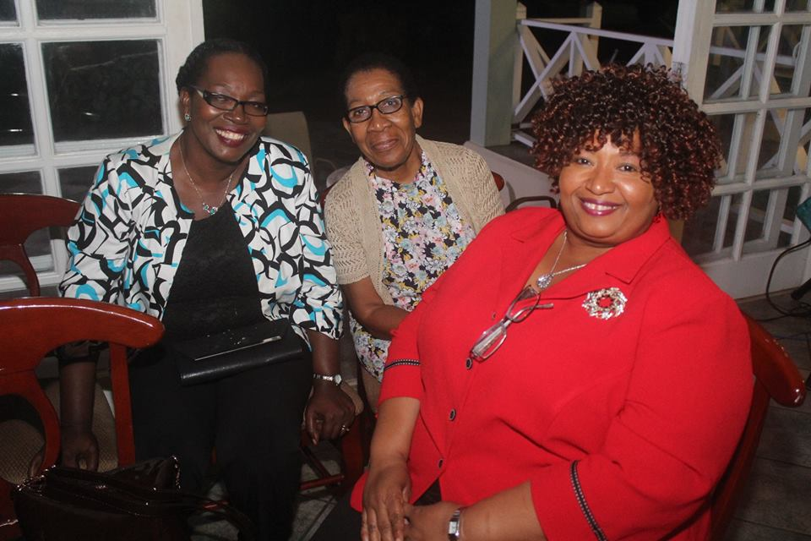
Mrs. Kathy Ann Greenidge Ottley (r), Primary Care Nursing Manager; Mrs. Michelle Edwards-Benjamin (l) and another attendee are all smiles as they enjoy the evening.

Slide 22
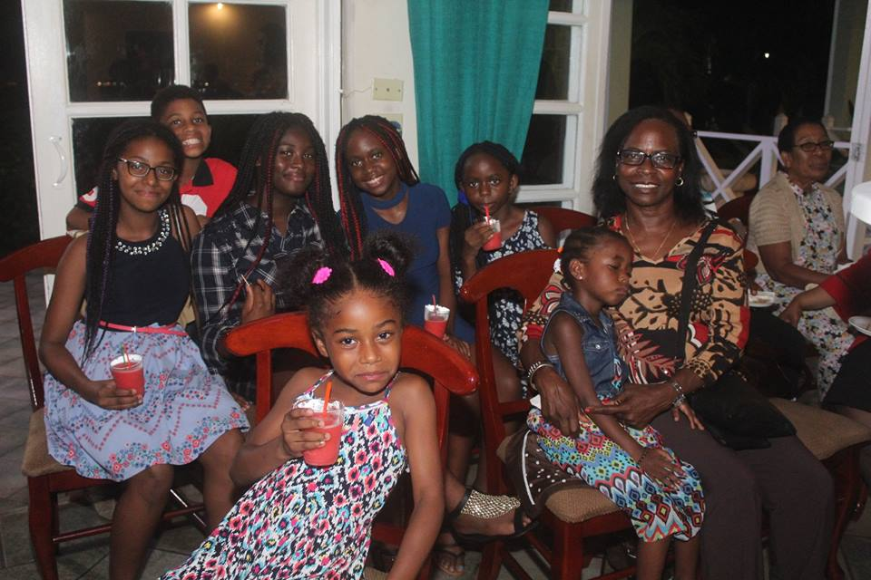
Members of the TPA also brought along their children on this 10th Medical Mission trip to Tobago.

Slide 23
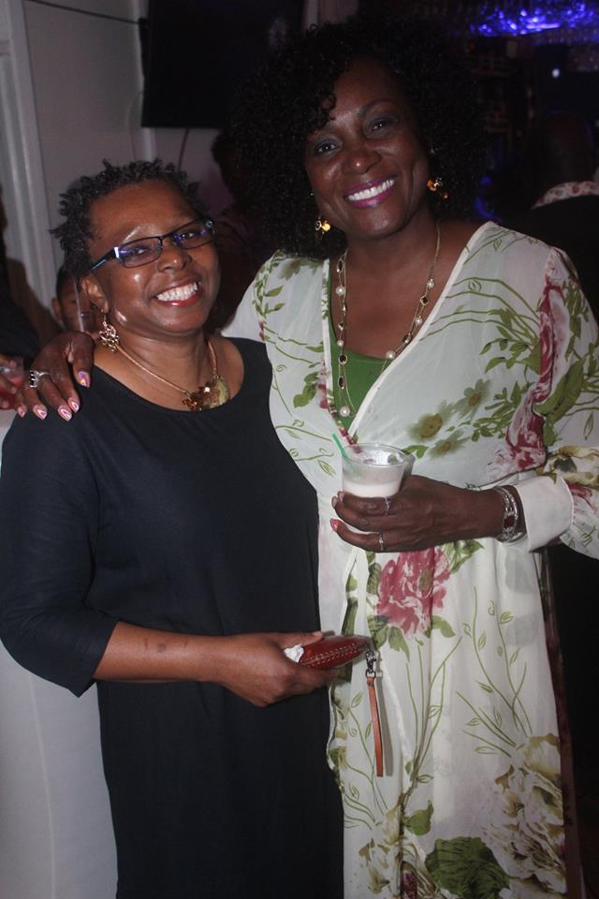

Slide 24
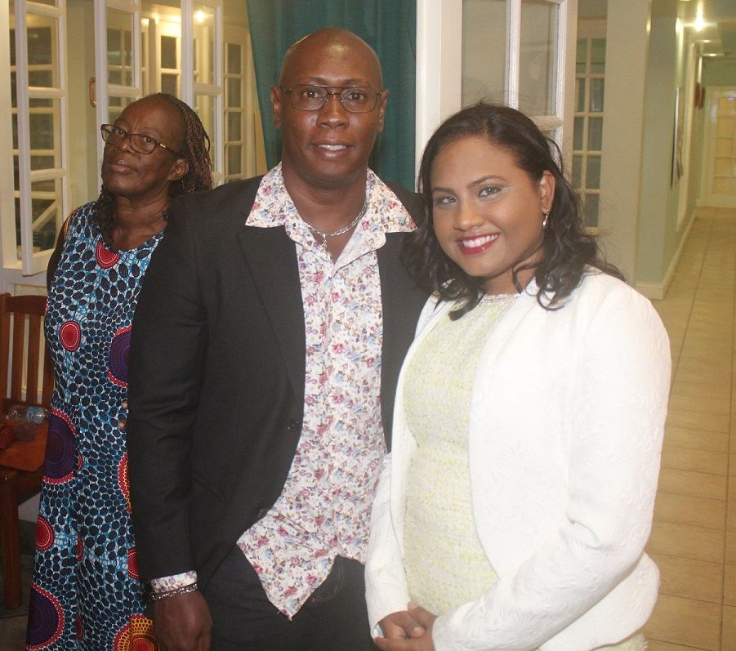
Heads of Department in attendance. Foreground from left: Mr. Nigel Phillip, Gender Officer and Ms. Devika Sammy Mediator. In the background is a member of the TPA.

