Slide 1
Canaan SDA Church
HEALTH FORUM and Health Fair
TPA 2018

Slide 2
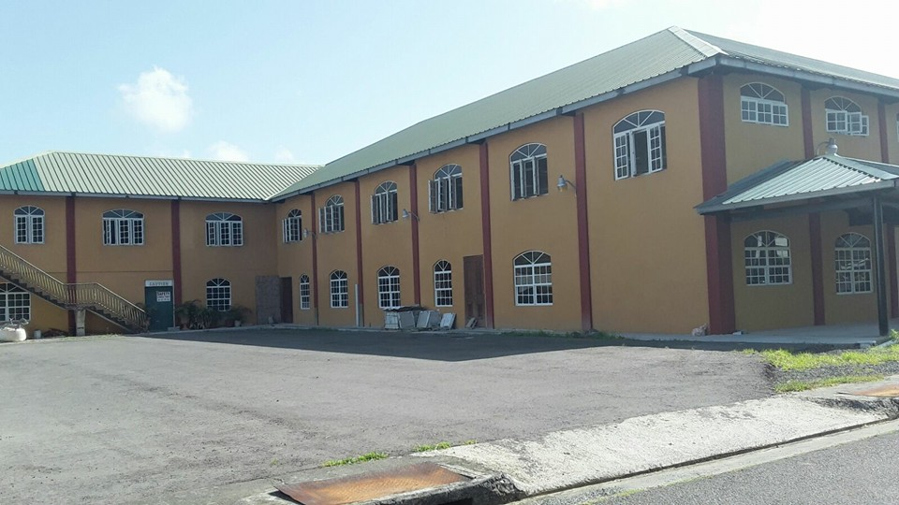

Slide 4
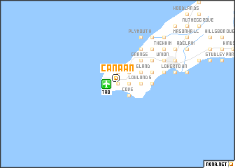
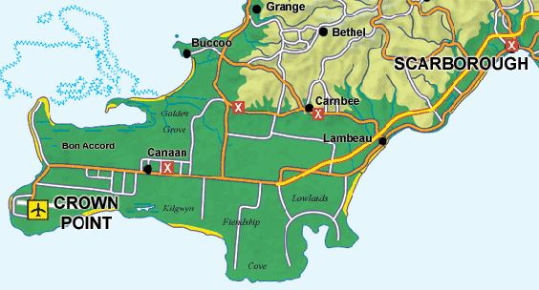

Slide 5


Slide 6


Slide 7
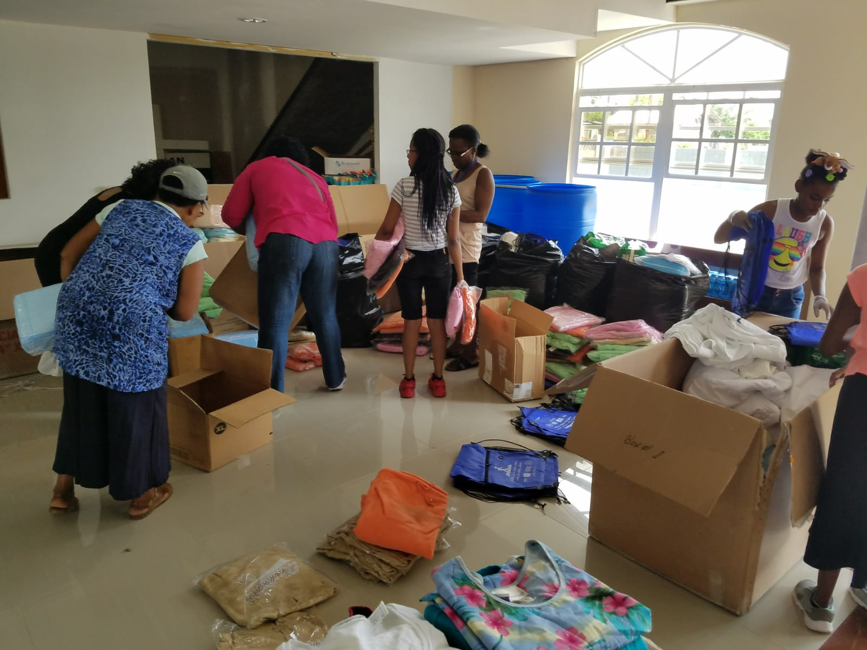

Slide 8
More to come

